Slide 1
SOEN 384
Management, Measurement and Quality Control http://users.encs.concordia.ca/~s384_2/
Lecture 7
Software Measurement Scale Types
Reading material Fenton Chapter 2, sections 2.1, 2.2.1, 2.3, 2.4.1 , 2.5, 2.6

Slide 2
Agenda
Review
Representational theory of measurement
Scale Types
Exercises
Next?
soen384-F15-L7: scale types

Slide 3
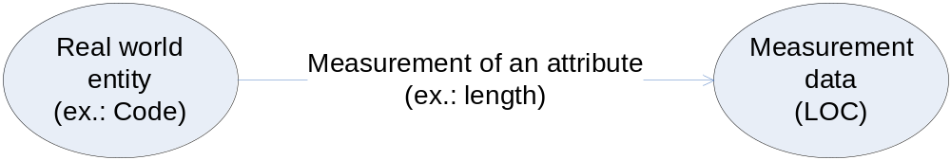
What is a Measurement?
Measurement is the process by which numbers or symbols are assigned to attributes of entities in the real world in such a way as to characterize them according to clearly defined rules.
soen384-F15-L7: scale types

Slide 4
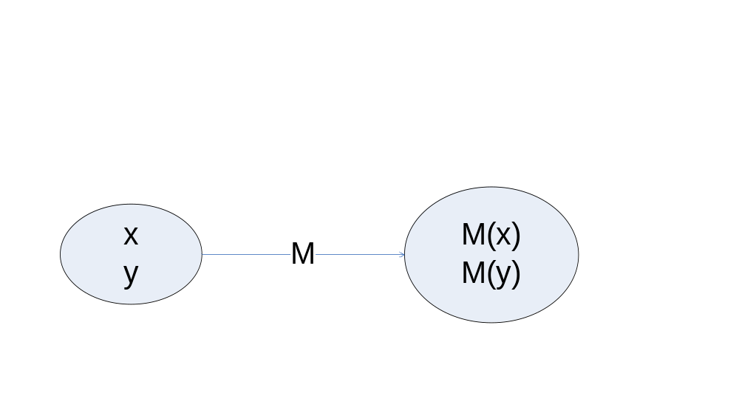

Representational Measurement Theory: Link between Measures & Empiricism
Representational theory of measurement:
  rigorous framework for determining when a proposed measure really does characterize the attribute it is supposed to.
1
2
3
x is taller than y ⬄ M (x) > M (y)
Where M(x) is the height of a person x.
y is taller than x
M (x) < M (y)
soen384-F15-L7: scale types

Slide 5
Agenda
Review
Representational theory of measurement
Scale Types
Exercises
Next?
soen384-F15-L7: scale types

Slide 6
Measurement is not about numbers!
Example 1:
  Assume there are four football players with the numbers 2, 4 , 6, 8 on their shirts.
  We now calculate the arithmetic mean
  AR=(2+4+6+8)/4 = 5
  Can we say that the player with number 5 represents the average performance of the four players?
  Answer: no because the numbers are only identification of the players …
soen384-F15-L7: scale types

Slide 7
Example on Meaningfulness
Categories of income sources of students:
  1=full-time work
  2=part-time work
  3=scholarship
Is the arithmetic mean of the scores meaningful?
John and Joe take math test
  John receives 80
  Joe receives 40.
Is the following statement meaningful?
“John knows twice as much as Joe”
soen384-F15-L7: scale types

Slide 8
Meaningfulness of the analysis of the measurement data and mathematical operations
Measurement data is a collection of numbers.
One can always perform mathematical operations on numbers (add them, average them, take logarithms, etc.)
What kind of mathematical manipulations are meaningful?
  Depends on the scale type of the measure
soen384-F15-L7: scale types

Slide 9
Agenda
Review
Representational theory of measurement
Scale Types
Exercises
soen384-F15-L7: scale types

Slide 10
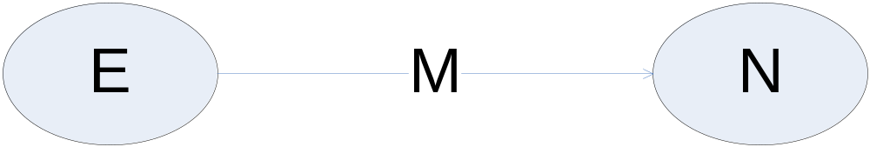
Measurement Scale –
Formal Definition
Scale: a triple < E, N, M> where
  E is the set of empirical (observed) phenomena,
  N is the set of numerical (mathematical) objects,
  M is the mapping between them using a valid and repeatable mechanism (homomorphism)
soen384-F15-L7: scale types
Notes:
homomorphism, (from Greek homoios morphe, “similar form”), a special correspondence between the members (elements) of two algebraic systems, such as two groups, two rings, or two fields. Two homomorphic systems have the same basic structure, and, while their elements and operations may appear entirely different, results on one system often apply as well to the other system. Thus, if a new system can be shown to be homomorphic to a known system, certain known features of one can be applied to the other, thereby simplifying the analysis of the new system.
Measurement Scale:
mapping of an empirical (observed) phenomena to numerical (mathematical) objects using a valid and repeatable measurement method

Slide 11
Meaningfulness and Scale Types of measurement data
Five Major Types:
  Nominal, Ordinal, Interval, Ratio, Absolute
  Represent differing degrees of empirical knowledge about entities and their attributes
  Shown in increasing level of richness of empirical knowledge
  Restrict analysis of measurement data [on the corresponding scale] to meaningful statistics
soen384-F15-L7: scale types

Slide 12

Nominal: classification scheme
Classification
  Partitions the set of empirical entities into categories (also called equivalence classes) with respect to a certain attribute
  Equivalence operation:
  No knowledge about relationships among categories
Empirical Requirements for the partitioning:
  Empirical Classes are jointly exhaustive
    ALL CATEGORIES TOGETHER SHOULD COVER ALL POSSIBLE CATEGORIES FOR THE ATTRIBUTE
  Empirical Classes are mutually exclusive
    A SIBJECT CAN BE CLASSIGIED INTO ONE AND ONLY ONE CATEGORY
Numerical Requirements:
  Math. Operation: =
  Stats: Frequency, Mode
  Each category is represented by a different number
soen384-F15-L7: scale types
Notes:
comes from Latin for name
Examples: blood types (A,B,AB,O); numbers on basketball or football uniforms.
SOEN337-W09-L10: theory (2)

Slide 13
Nominal Scale Type:
Example 2.6, Fenton
Entity: software failure
Attribute: criticality
Categories of software failures according to their criticality:
  R1: delayed response
  R2: incorrect output
  R3: data loss
soen384-F15-L7: scale types

Slide 14
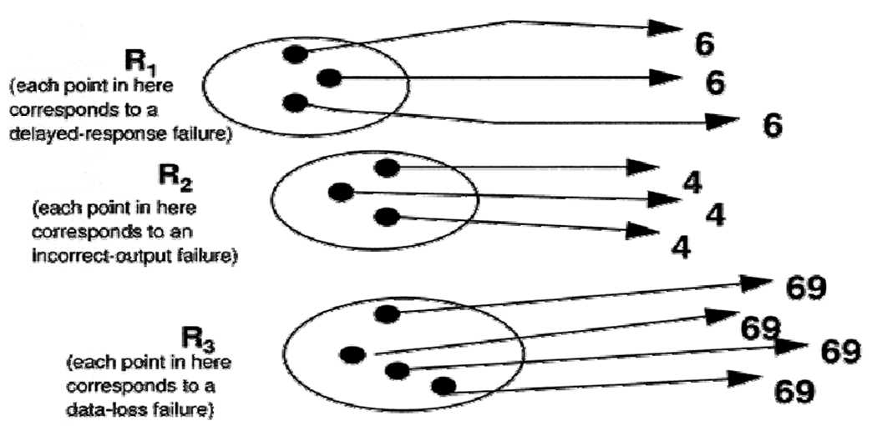
Example 2.6:
Measurement Method
soen384-F15-L7: scale types

Slide 15
Back to the 1st example: more formal answer
…
  Assume there are four football players with the numbers 2, 4 , 6, 8 on their shirts.
  Scale type?
  We now calculate the arithmetic mean
  AR=(2+4+6+8)/4 = 5
  Is AR a meaningful statistical data?
  Answer: no because the arithmetic mean is not a meaningful mathematical operation on the nominal scale.
soen384-F15-L7: scale types

Slide 16
Ordinal:
comes from Latin name for order;
Useful to augment the nominal scale with information about an ordering of the categories.
involves rank ordering items (“>”, “<”, “=”)
higher number indicates more of the characteristic being measured;
the intervals between adjacent values are indeterminant.
The numbers represent ranking only, so addition, subtraction, and other arithmetic operations have no meaning.
soen384-F15-L7: scale types

Slide 17
Example 2.6: from Nominal to Ordinal
Next: add a new binary relation x more critical than y :
  Each data loss failure (R3) is more critical than incorrect output (R2) and delayed response failure (R1)
  Each incorrect failure (R2) is more critical than delayed response failure (R1)
The measurement method shall be revised to account for this new binary relations
soen384-F15-L7: scale types

Slide 18
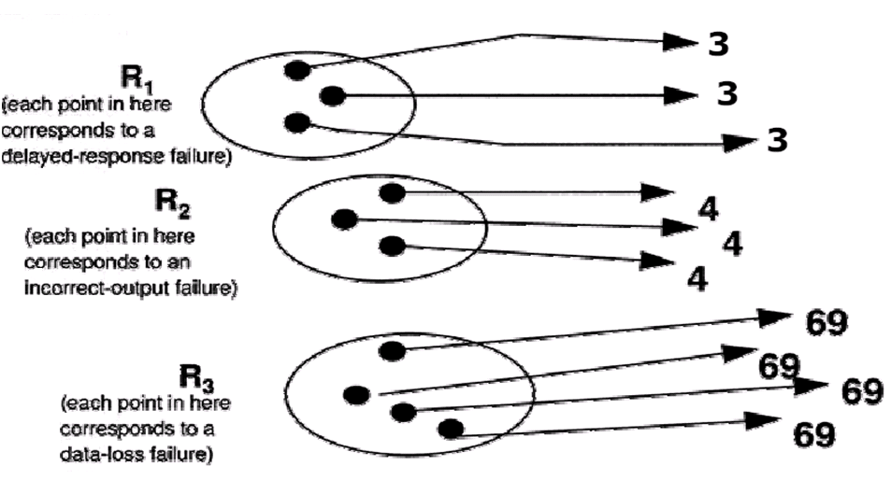
Example 2.6:
Revised Measurement Method
soen384-F15-L7: scale types

Slide 19
Ordinal Scale Type: Meaningful mathematical operations
Examples of Permissible Statistics & Statistical tests:
  All nominal scale statistics
  Median
  Rank order statistics (f.e, Spearman’s correlation coefficient)
  Non-parametric
soen384-F15-L7: scale types

Slide 20
Exercises on Nominal and Ordinal Scale Types
Determine the scale type of:
  Gender
  Marital status
  Distance
  Intelligence Score
  “Yes-No” voting system
  Blood types (A,B,AB,O)
  Letter grade system
soen384-F15-L7: scale types

Slide 21
Interval Scale Type
Requires well-defined unit of measurement
Empirical requirements:
  preserves equivalence classes, as with the nominal scale
  Preserves order, as with the ordinal scale.
  Scale has arbitrary zero, therefore, ratio is meaningless
  An interval scale preserves differences but not ratios.
Numerical Requirements:
  Math. Operations: =, <, >, +, -
soen384-F15-L7: scale types
Notes:
Interval Scale
There is a equal number of divisions between two points
This scale captures information about the size of the intervals (distance) that separate the categories, so that we can in some sense understand the size of the jump from one category to another. That is, we know the difference between any two of the ordered categories in the range of the mapping, but computing the ratio of two categories in the range does not make sense. A good example of an interval scale is the Fahrenheit scale for temperature. Equal differences on this scale represent equal differences in temperature, but a temperature of 30 degrees is not twice as warm as one of 15 degrees.
zero on this scale does not indicate an absence of the characteristic being measured; because true zero is absent, cannot establish ratios; for example, a temperature of 100 degrees cannot be interpreted as twice as hot as 50 degrees
Addition and subtraction are acceptable on the interval scale, but not multiplication and division.
SOEN337-W09-L10: theory (2)

Slide 22
Ratio Scale Type
Well-defined unit of measurement
Empirical requirements:
  preserves ordering, the size of intervals between entities, and ratios between entities.
  There is a zero element, representing total lack of the attribute.
Numerical requirements:
  The measurement mapping must start at zero and increase at equal intervals, known as units.
  All arithmetic can be meaningfully applied to the classes in the range of he mapping.
Examples of Statistics & Permissible Statistical tests:
  All that apply to interval scale, percentage, coefficient of variation
  Non-parametric and parametric
=, <, >, +, - , *, /
soen384-F15-L7: scale types
Notes:
Examples of Statistics & Permissible Statistical tests:
All that apply to interval scale, percentage, coefficient of variation
Non-parametric and parametric
SOEN337-W09-L10: theory (2)

Slide 23
Ratio Scale Type: Example
    Given two distances D1=10km and D2=5km:
    Can we say that the distance D1 is twice as long as the distance D2? (D1=D2*2)
    Will this statement be meaningful if the length is measured in meters or yards?
soen384-F15-L7: scale types

Slide 24
Absolute Scale
The absolute scale is the most restrictive of all. There is only one way to measure it and there is only one unit per absolute measure!
Properties:
  The measurement on the absolute scale is made simply by counting the number of elements in the entity set.
  There is only one possible measurement mapping.
  All arithmetic analysis of the resulting count is meaningful.
soen384-F15-L7: scale types
Notes:
SOEN337-W09-L10: theory (2)

Slide 25
Exercises on Scale Types
Determine the scale type of:
  US quality of beef rating
  Annual Income in $
  Distance
  Weight
  Number of developers in a team
  Length
  Duration of time in a project
  Kelvin temperature scale
soen384-F15-L7: scale types
Notes:
SOEN337-W09-L10: theory (2)

Slide 26
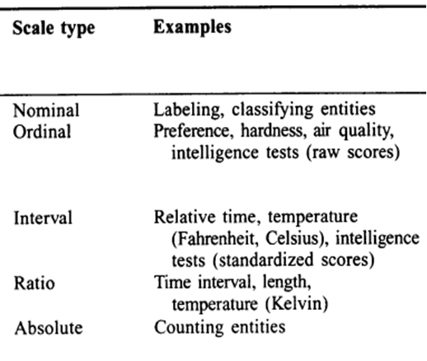
More Examples:
soen384-F15-L7: scale types
Notes:
SOEN337-W09-L10: theory (2)

Slide 27
Base Measures v.s. Derived Measures
A measure is base (direct) if it directly characterizes an empirical property and does not require the prior measurement of some property
Derived (indirect) measures: use one or more fundamental measures of one or more attributes to measure, indirectly, another supposedly related attribute.
  Requires first the measurement of two or more attributes
  Then it combines them using a mathematical model of some kind, according to the laws imposed by the empirical model.
soen384-F15-L7: scale types
Notes:
Conjoint measures: measure the attribute and its components simultaneously => direct measure

Slide 28
Representation condition for derived measurement
Software A’s quality is good. 3 defects
Software B’s quality is better. 15 defects
/10 LOC
/1 KLOC
worse
to measure is to assign numbers to quality attribute of Software A and Software B according to clearly defined rules;
“defect”, “KLOC” are measurement units
“reliable”, “more reliable” are relations.
soen384-F15-L7: scale types

Slide 29
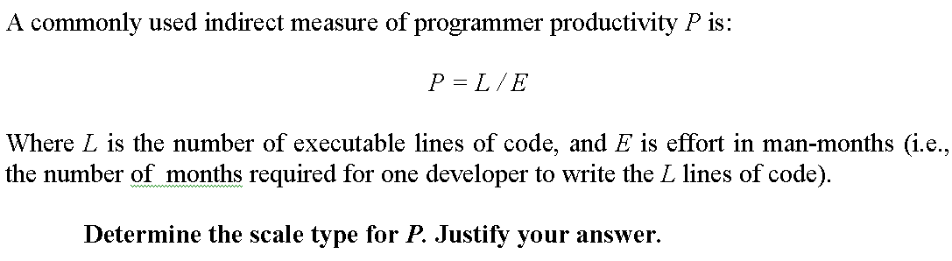
Scale Types of Derived Measure. Example
Scale of an indirect measure M will generally be the weakest of the scale types of the direct measures
soen384-F15-L7: scale types

Slide 30
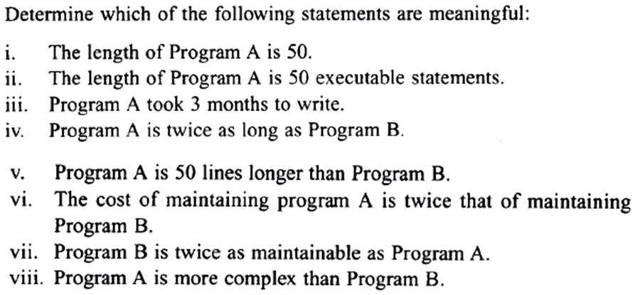
More exercises on meaningfulness
(in class)
soen384-F15-L7: scale types

Slide 31
TO-DO list:
READ Chapter 2, Fenton (sections 2.1, 2.2.1, 2.3, 2.4.1 , 2.5, 2.6)
soen384-F15-L7: scale types

Slide 32
Next?
ISO 15939
Swebok
soen384-F15-L7: scale types

Slide 33
Questions?
…
soen384-F15-L7: scale types

